Slide 1
Startup Profit Analysis
Regression Analysis & Dashboard Insights
Presented by: Vikram Bhagnani
Date: 09/04/2025

Slide 2
Objective of the Analysis
Content:
Perform regression to understand how R&D, Marketing, and Admin spending affects profit
Visualize data using Power BI to gain insights
Provide actionable recommendations to improve profit

Slide 3
Regression Analysis
Profit = 50122.19 + (0.8057 × R&D Spend) − (0.0268 × Administration) + (0.0272 × Marketing Spend)
Coefficient | Value
Intercept | 50122
R&D Spend | 1
Administration | 0
Marketing Spend | 0

Slide 4
Predicted Profits
Prediction for Given Inputs:
R&D Spend | Administration | Marketing Spend | Predicted Profit
$21,892.92 | $81,910.77 | $164,270.70 | $70,038.00
$23,940.93 | $96,489.63 | $137,001.10 | $70,555.00

Slide 5
Regression Insights
1. R&D Spend has the strongest positive impact on Profit.
2. Marketing Spend has a moderate influence.
3. Administration Spend shows little to no correlation with Profit.
4. Focus should be on optimizing high-impact areas.

Slide 6
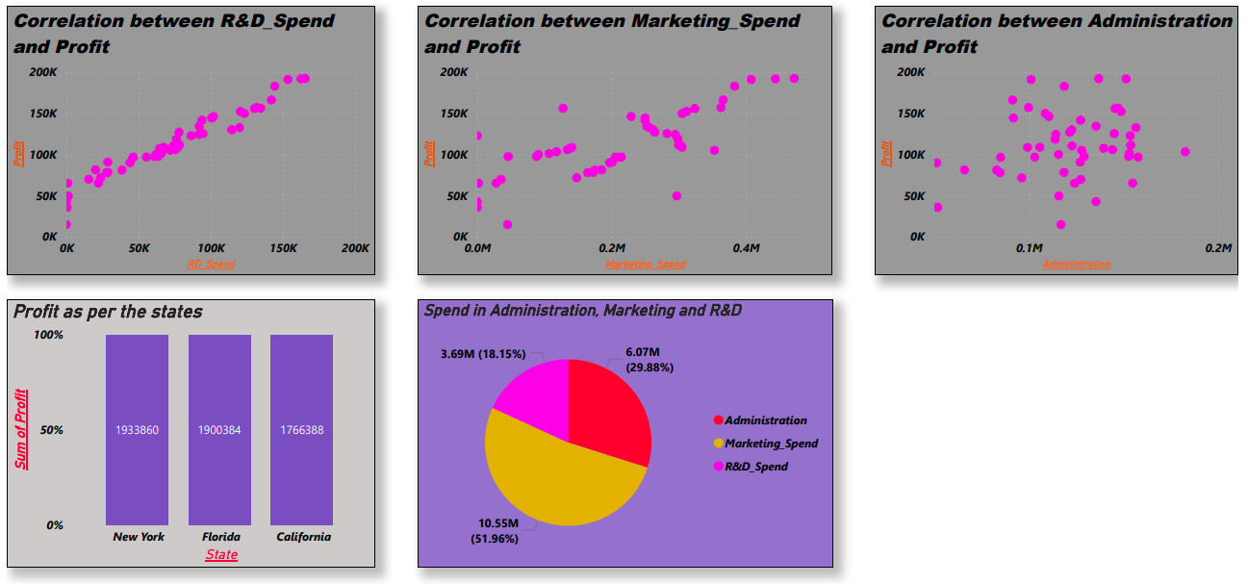
Dashboard

Slide 7
Insights from Dashboard:
R&D vs Profit Shows Strong Positive Correlation
Marketing shows variable returns
Admin spending does not increase profit
Some companies achieve high profit with lower spend

Slide 8
Based on Analysis:
Increase investment in R&D for better profitability
Reevaluate marketing strategies to improve ROI
Streamline administrative expenses
Track high-performing companies for strategy alignment

Slide 9
Thank You!
Feel free to ask any questions.

